Slide 1
Life Expectancy Analysis
Project 1 - Group 3
Assiba Lea, Elizabeth, Jonathan, Sebastian & Sheryle
August 2024

Slide 2
Introduction
Objective:
The purpose of our analysis on life expectancy is to uncover potential patterns that affect the life expectancy in different communities. We aim to do this by analyzing the correlations between factors such as; country development status, disease management, immunization coverage, and expenditure per citizen.
Dataset Overview:
The life expectancy dataset used was sourced through Kaggle and uses data collected from the World Health Organization and United Nations data repository websites. It consists of 22 columns and 2938 rows with 20 key variables.
Source: Kaggle

Slide 3
Problem Statements
Industry Focus: Healthcare
Research Questions:
1A. How does the life expectancy of individuals in developed countries compare to those in developing countries?
1B. What is the life expectancy trend by country?
2. What is the standalone most impactful factor to life expectancy?
3. Is there a correlation between immunization coverage for Hepatitis B, Polio, Diphtheria and life expectancy?
4. Is there a correlation between a country's healthcare expenditure per capita and its life expectancy?

Slide 4
Methodology
Data Collection:
The dataset was obtained from Kaggle.com
Data Cleaning:
The accuracy and reliability of the dataset was improved by removing incomplete entries. Entries with no data present (missing values) were removed from the analysis.
Analysis Techniques:
Data visualizations
Correlation heatmap, linear regression trendlines, box and whisker plot, histogram, violin graph, scatterplot

Slide 5
Exploratory Data Analysis
We made sure our data was clean
(data that was able to be manipulated numerically without ValueErrors )
Reviewed the distribution of life expectancy via histogram
Created a Correlation Matrix aka Heatmap to identify the relationships between variables
Research question formulation based on our initial findings we created questions categorically and by importance.
Notes:
Data Loading and Cleaning:
We began by loading the dataset into a Jupyter notebook using pandas.
We performed initial data cleaning, handling missing values, and ensuring correct data types for each column.
Exploratory Data Analysis (EDA):
We used descriptive statistics (df.describe()) to understand the distribution of key variables.
We examined the dataset's structure, including the number of countries, years covered, and available features.
Correlation Analysis:
We created a correlation matrix to identify relationships between variables.
This analysis highlighted schooling as a strong correlate with life expectancy.
Visualization Techniques:
We employed various visualization methods, including scatter plots, heatmaps, and violin plots.
The violin plot of schooling vs. life expectancy (as shown in the attached image) was particularly insightful.
Research Question Formulation:
Based on our initial findings, we formulated research questions to guide deeper analysis.
These questions were developed by consensus via inspiration by other longevity healthprojects, categorically by reviewing the headers of the data. And by importance I mean to ascertain impactful answers and reverse engineer to determine questions that can lead us there
That led us to our focus across four questions which we will be thrilled to cover with you

Slide 6
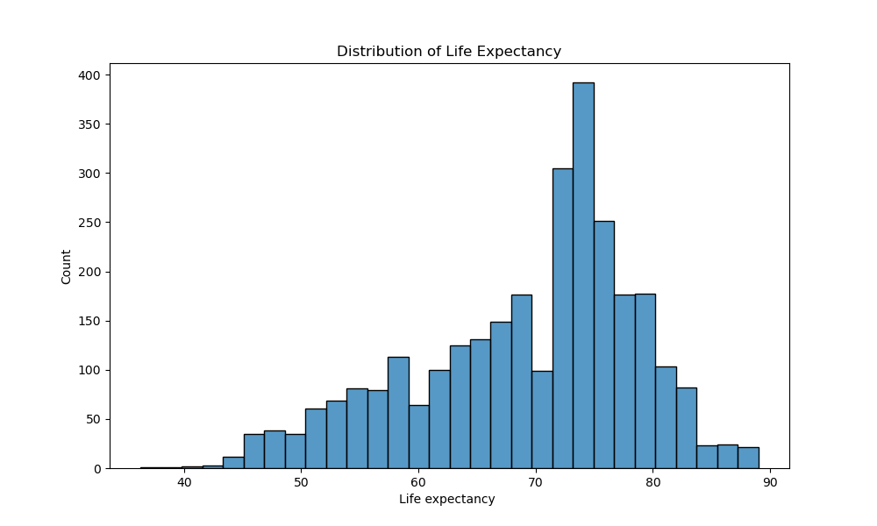
Life Expectancy Distribution

Slide 7
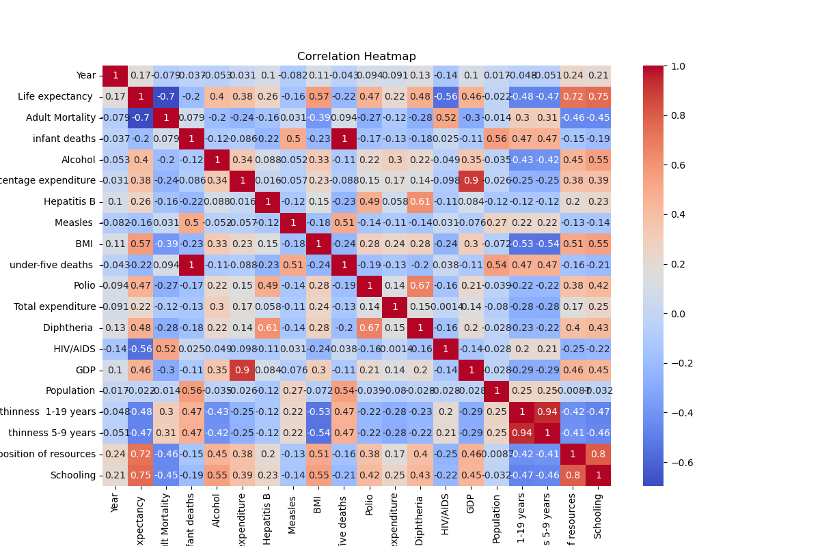
Correlation Matrix (Heatmap)

Slide 8
Detailed Analysis - Question 1
Question:
How does the life expectancy of individuals in developed countries compare to those in developing countries?
Analysis:
The data was analyzed to show the distribution of countries by status and trend the average life expectancy over between 2000 and 2015.
Summary:
Developed countries represent 16% (n=32) of all countries (n=193) in the dataset.
The difference in average life expectancy increased for both developed and developing countries with an approximate 10 year gap between 2000 and 2015.
Several developing countries exceeded the highest average life expectancy of developed countries at some point and no developed countries fell below the highest average life expectancy of developing countries at any point.
Notes:
Developed countries are correlated with a longer life expectancy but developing countries does not always correlate with a lower life expectancy. The average life expectancy in developing country has a large range likely attributed a larger sample size and confounding variables.

Slide 9
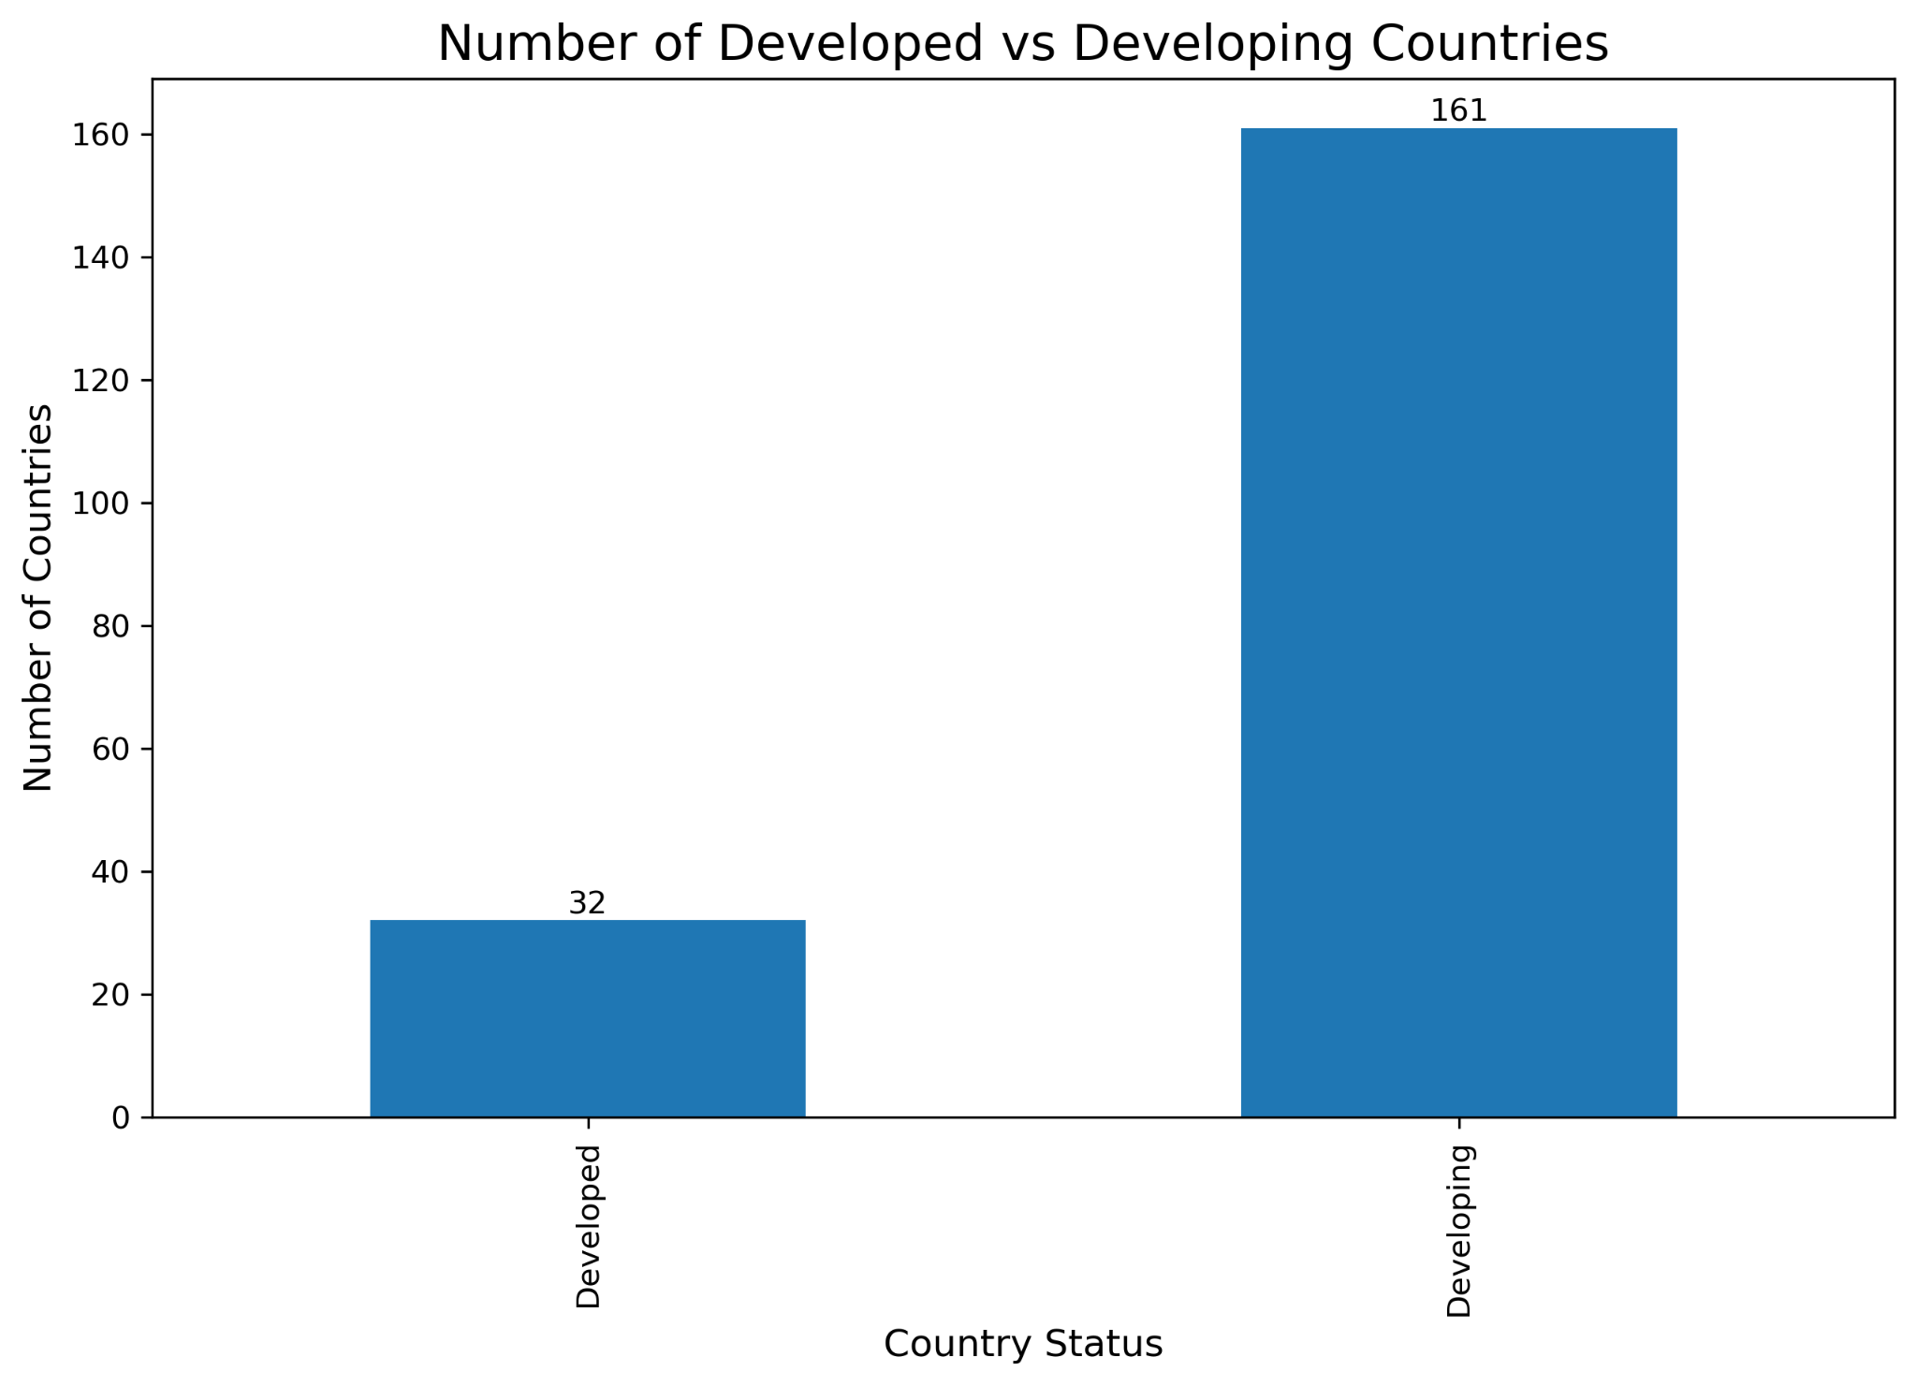
Notes:
Developed countries account for 32 (16%) of the 193 countries included.

Slide 10
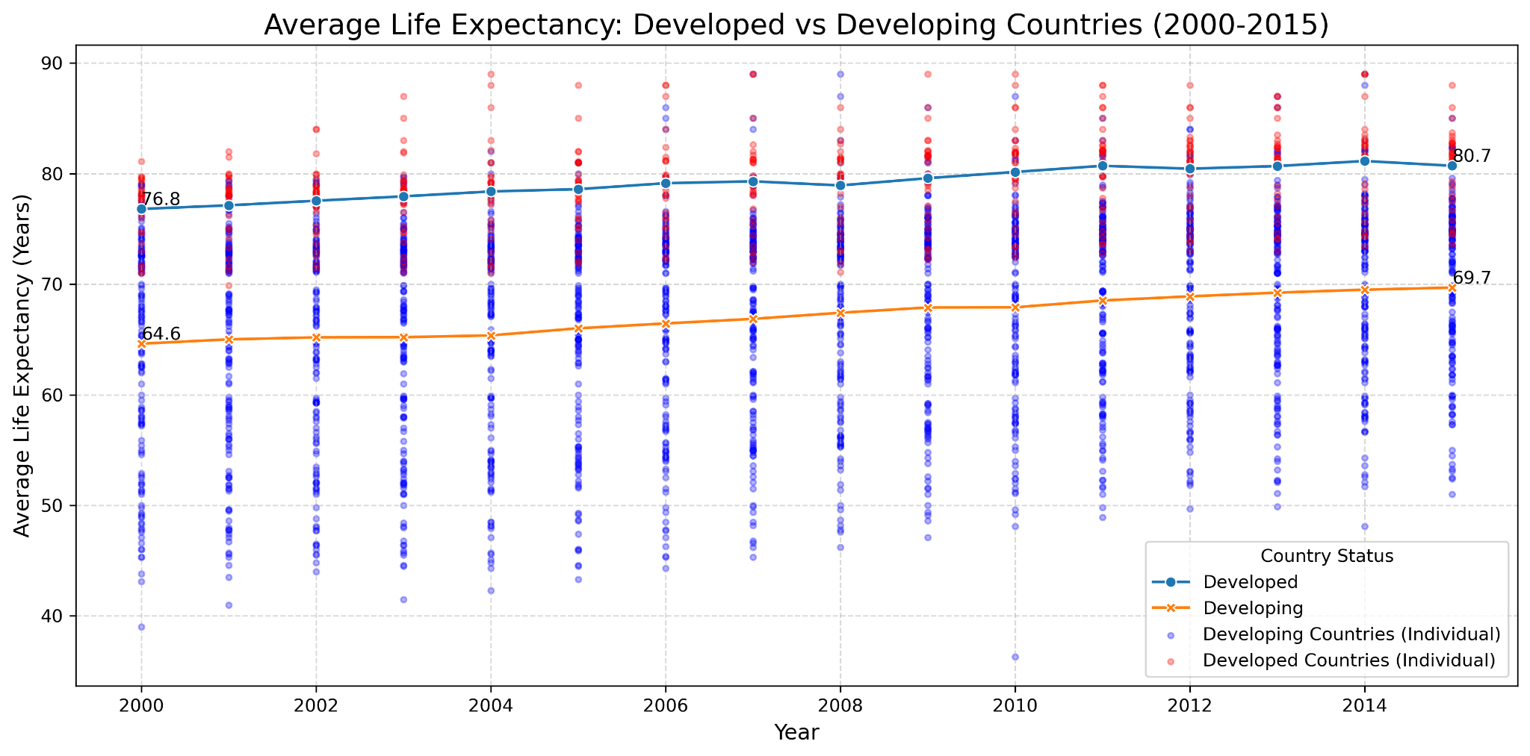
Notes:
Average life expectancy for developing and developed countries gradually increased over the years and consistently had approximate 10 year difference.

Slide 11
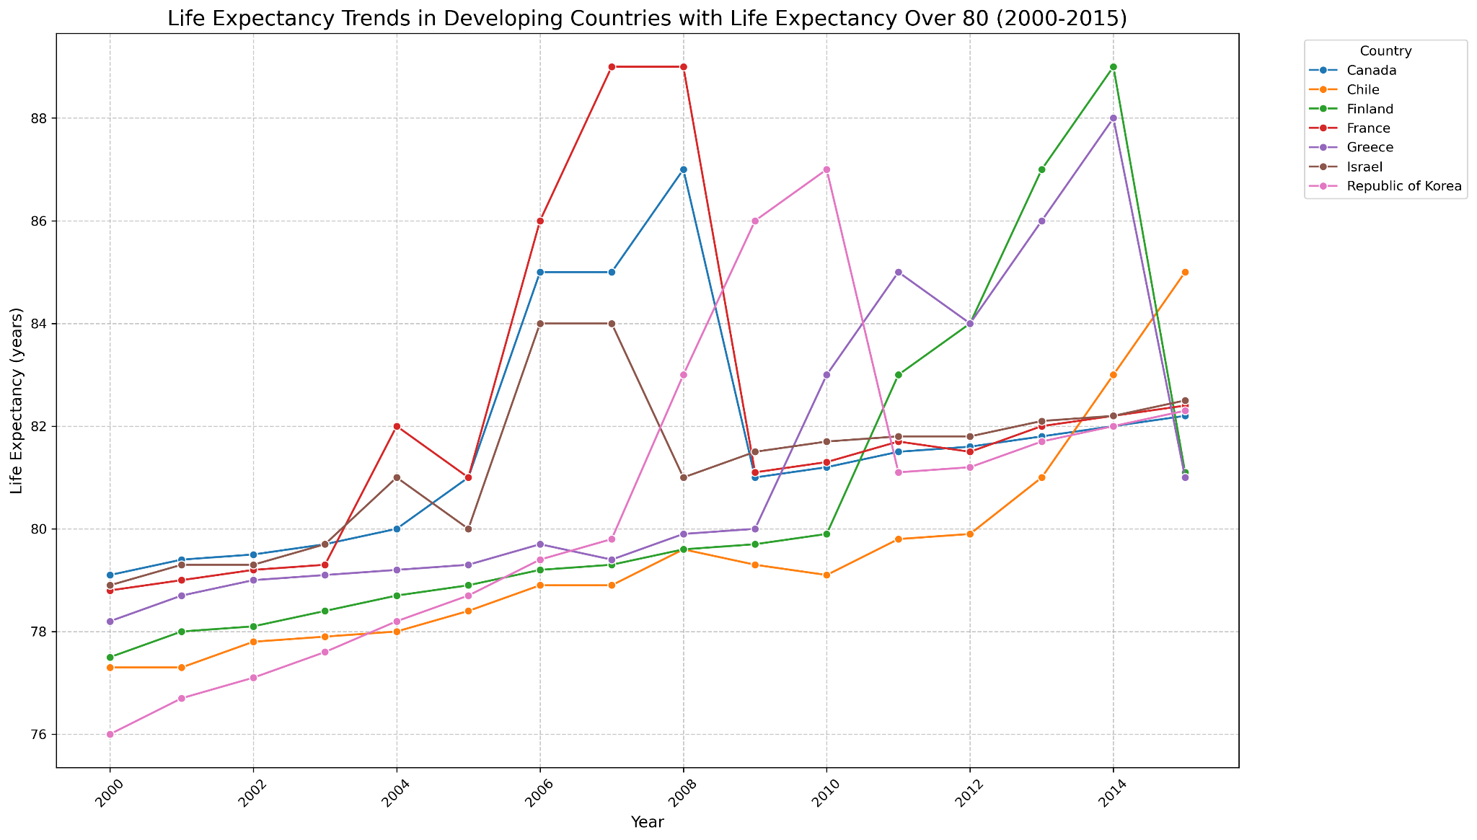

Slide 12
Detailed Analysis - Question 2
Question:
Is there a correlation between a country’s healthcare expenditure per capita and its life expectancy?
Analysis:
The healthcare expenditure per capita correlation to life expectancy was analyzed using the data set to create a scatter plot and line plot.
Summary:
There is a very slight positive correlation between healthcare expenditure and life expectancy as a slight trend upwards is shown from age groups 70-80. An increase in healthcare expenditure shows to have a generally positive affect in life expectancy.

Slide 13
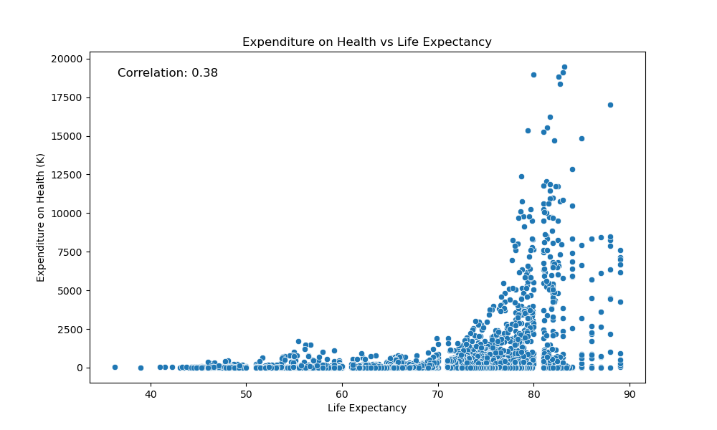
Detailed Analysis - Question 2
Analysis:
r= 0.38
Slightly positive correlation
Implications:
Expenditure on health has a slight correlation to life expectancy.
Expenditure on health affected the life expectancy of age groups 70- 83 the most.

Slide 14
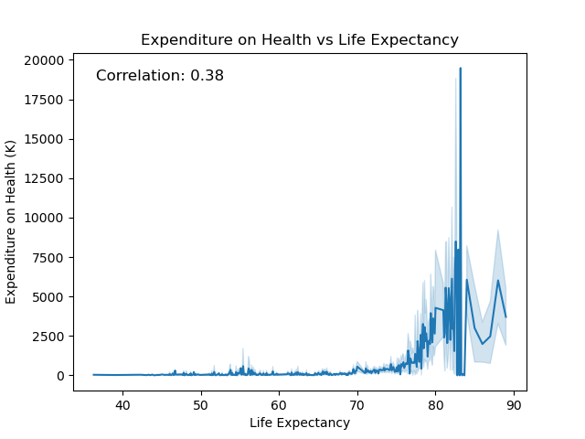
Detailed Analysis - Question 2
Analysis:
r= 0.38
The highest expenditure on health was $19,500 with an 83 years of age life expectancy.
The highest life expectancy was 89 years of age.
Implications:
As expenditure on health steadily increases, life expectancy slightly increases.
The heavy decrease after the highest expenditure is shown clearly through the line plot at age 84.

Slide 15
Detailed Analysis - Question 3
Question:
Is there a correlation between immunization coverage for Hepatitis B, Polio, Diphtheria and life expectancy?
Analysis:
Dataset was analyzed to find the correlation between immunization for Hepatitis B, Polio and Diphtheria and its’ overall impact to life expectancy
Three individual scatter plots were created to visualize the data
Independent variables: Hep B, Polio and Diphtheria immunization coverage
Dependent variable: Life expectancy
Summary:
Immunization coverage generally increased life expectancy and lowered the incidence of these diseases among the sample population

Slide 16
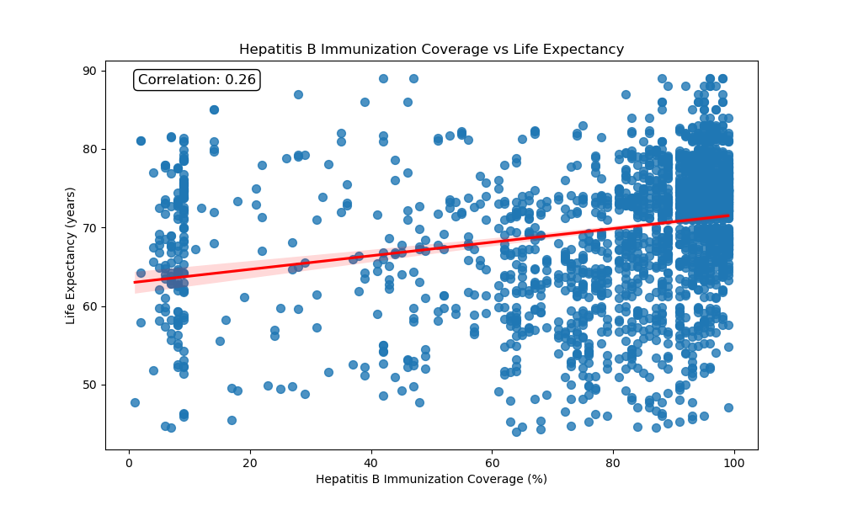
Detailed Analysis - Question 3 (cont.)
Hepatitis B vs. Life Expectancy
Analysis:
Immunization Effectiveness
Slightly positive correlation with life expectancy
r= 0.26
Implications:
Life Expectancy Impact
As Hep B immunization increases,
Life expectancy slightly increases
Hep B immunization can help reduce the risk of chronic hepatitis B, which can lead to liver cirrhosis (scarring/damage) and cancer
Hep B immunization enhances liver function and reduces mortality
Notes:
Explain - Each data point represents one country’s immunization coverage for a specific year. Dataset contains data from 193 countries from years 2000-2015.
Linear regression line analyzes the relationship between the two variables

Slide 17
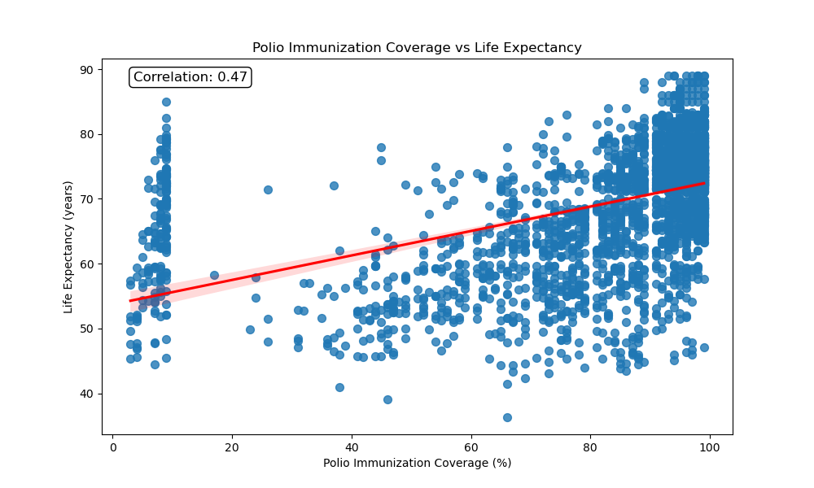
Detailed Analysis - Question 3 (cont.)
Polio vs. Life Expectancy
Analysis:
Immunization Effectiveness
Moderately positive correlation with life expectancy
r= 0.47
Implications:
Life Expectancy Impact
Polio immunization increases,
Life expectancy moderately increases
Polio immunization prevents poliomyelitis, a disease that causes paralysis and disability
Notes:
Explain - Each data point represents one country from a specific year. Dataset contains data from 193 countries from years 2000-2015.

Slide 18
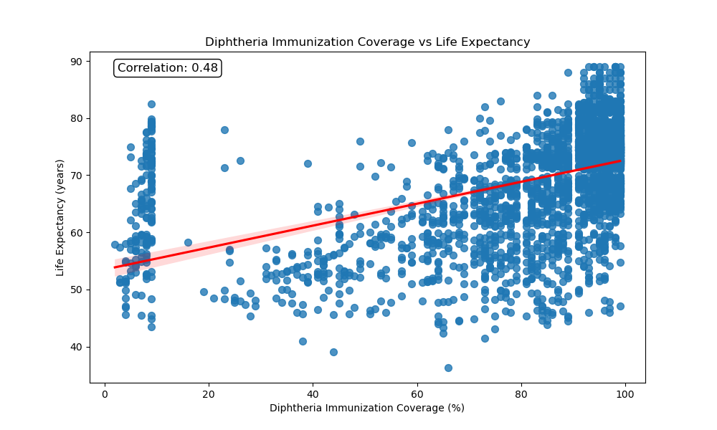
Detailed Analysis - Question 3 (cont.)
Diphtheria vs. Life Expectancy
Analysis:
Immunization Effectiveness
Moderately positive correlation with life expectancy
r= 0.48
Implications:
Life Expectancy Impact.
Diphtheria immunization increases,
Life expectancy moderately increases
Diphtheria immunization protects against diphtheria, which can cause severe breathing problems and heart issues
Notes:
Explain - Each data point represents one country from a specific year. Dataset contains data from 193 countries from years 2000-2015.

Slide 19
What are the top 10 factors of life expectancy?
Schooling 0.751975
Income composition of resources 0.724776
BMI 0.567694
Diphtheria 0.479495
Polio 0.465556
GDP 0.461455
Alcohol 0.404877
percentage expenditure 0.381864
Hepatitis B 0.256762
Total expenditure 0.218086
Year 0.170033
Population -0.021538
Measles -0.157586
infant deaths -0.196557
under-five deaths -0.222529
thinness 5-9 years -0.471584
thinness 1-19 years -0.477183
HIV/AIDS -0.556556
Adult Mortality -0.696359

Slide 20
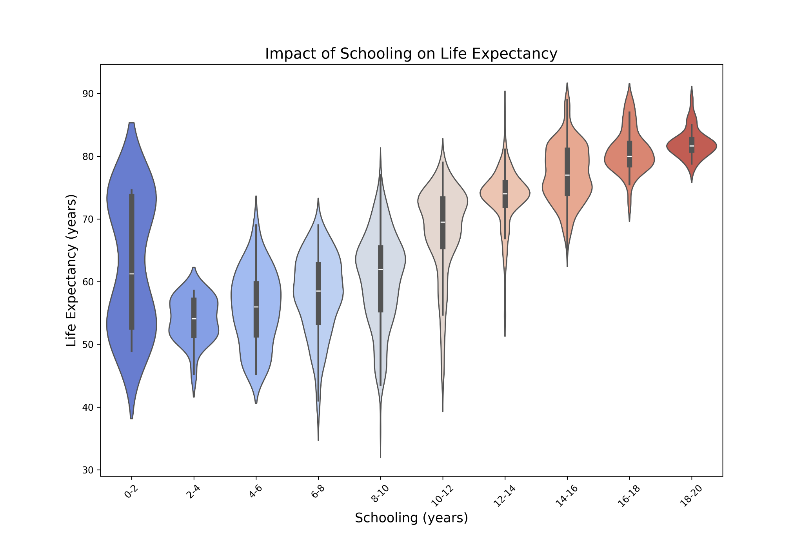
Detailed Analysis - Question 4
What is the standalone most impactful factor to life expectancy?
Analysis: As schooling increases, life expectancy shifts upwards. The interquartile range of as individuals attended more years of schooling shrinks. An additional trend is the increased density of values towards the mean as schooling years increase.
Implications: What can be determined is that variability in life expectancy decreases while mean life expectancy increases.
Notes:
This violin plot shows the distribution of life expectancy across different schooling levels.

Slide 21
Conclusion Pt. 1 Summary of Findings
Developed countries are correlated with a longer life expectancy but developing countries does not always correlate with a lower life expectancy.
Healthcare Expenditure: There is a significant correlation between healthcare expenditure per capita and life expectancy (0.38). Countries that invest more in healthcare tend to have a higher life expectancy.
Immunization Coverage (Ranked order): Diphtheria (0.48), Polio (0.47), Hepatitis B (0.26) and life expectancy. Countries with higher immunization rates tend to have higher life expectancy, highlighting the importance of vaccination programs in public health.
Most Impactful Factor: School identified as the most impactful standalone factor on life expectancy, with a strong positive correlation. Higher levels of education are associated with longer life expectancy, underscoring the role of education in promoting health.

Slide 22
Conclusion Pt. 2 - Recommendations
Recommendations
Enhance Education Access
Strengthen Immunization Programs
Increase Healthcare Investment
Implementing New Policy Approaches: Developing countries can create a comprehensive strategy to improve life expectancy by introducing policies modeling high life expectancy nations.
Notes:
Recommendations
Enhance Education Access: Governments should focus on improving access to quality education as a means to boost life expectancy. Policies that reduce educational disparities can lead to better health outcomes.
Strengthen Immunization Programs: Expanding and maintaining high coverage of immunization programs is crucial for improving life expectancy. Public health campaigns should emphasize the importance of vaccinations.
Increase Healthcare Investment: Countries should prioritize healthcare spending to ensure that all citizens have access to necessary medical services. Investments in healthcare infrastructure and services can lead to significant improvements in life expectancy.
Integrated Policy Approaches: Combining efforts in education, healthcare, and economic development can create a comprehensive strategy to improve life expectancy across different populations.

Slide 23
Conclusion Pt. 3 - Future Work
Future Work
Longitudinal Impact Studies
Quality of Education
Regional and Cultural Factors
Policy Effectiveness
Notes:
Longitudinal Impact Studies: Conduct longitudinal studies to better understand the causal relationships between education, healthcare, and life expectancy over time.
Quality of Education: Investigate how the quality of education, not just the quantity, affects life expectancy. This includes examining different educational systems and curricula.
Regional and Cultural Factors: Explore how regional and cultural factors influence the relationship between education, healthcare, and life expectancy. Understanding these nuances can lead to more tailored and effective interventions.
Policy Effectiveness: Evaluate the effectiveness of current policies aimed at improving life expectancy and identify areas for improvement or innovation.

Slide 24
Questions / Comments?

Slide 25
References
Data Sources:
Kaggle Life Expectancy Dataset
Tools and Libraries:
pandas
numpy
matplotlib.pyplot
Seaborn
Inspo:
https://www.kaggle.com/code/varunsaikanuri/life-expectancy-visualization

